Slide 1
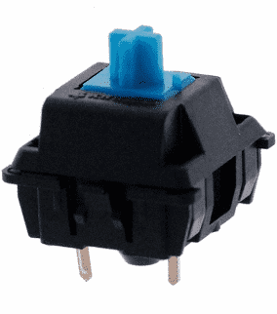
Ordering H8 Custom Keycaps for MX Switches
By: Norberto Collado

Slide 2
Here is the product page for our H8 to purchase. https://www.maxkeyboard.com/custom-terminal-keycaps.html

Slide 3
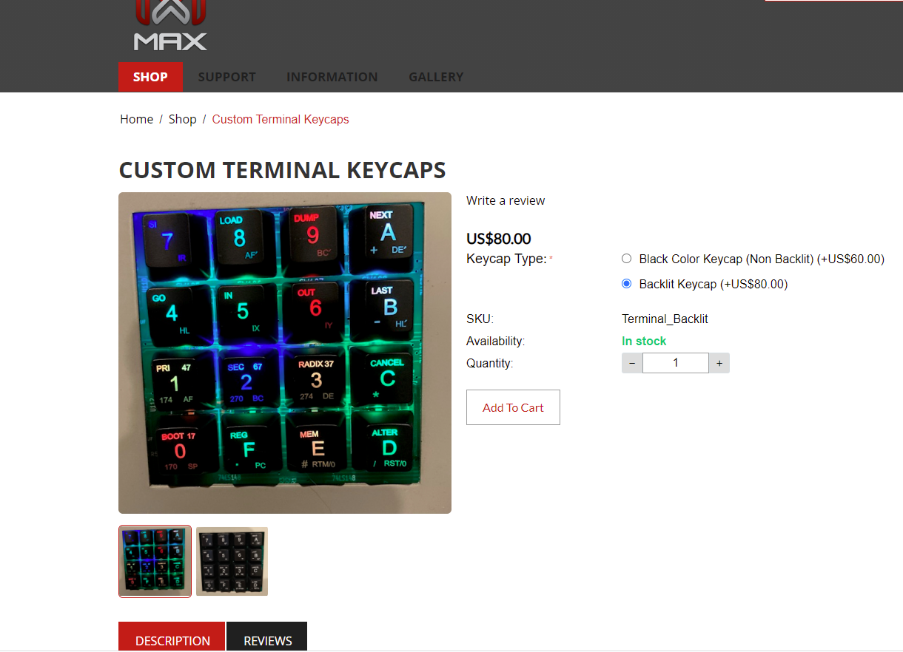
Please select H8 Custom “Keycap type”, click on “Add to Cart”, and proceed to order your custom keycaps.
https://www.maxkeyboard.com/custom-terminal-keycaps.html

